Slide 1
Network Innovation using OpenFlow A Survey
Author: Adrian Lara, Anisha Kolasani, and Byrav Ramamurthy
Publisher: IEEE COMMUNICATIONS SURVEYS & TUTORIALS
Presenter: Yu Hao, Tseng
Date: 2013/10/02

Slide 2
Outline
Introduction
Background of Programmable Networks
Openflow Specification
Capabilities of Openflow
Openflow-based Applications
Performance of Openflow-based Networks
Challenges of Openflow-based Networks

Slide 3
Introduction
A recent approach to programmable networks is the Software Defined Networking (SDN) architecture.
SDN consists of decoupling the control and data planes of a network.
The authors identify that it is difficult for the networking research community to test new ideas in current hardware.
The goal of OpenFlow was to provide a platform that would allow researchers to run experiments in production networks.

Slide 4
Background of Programmable Networks
SOFTNET and ActiveNetworks did not use software components to control the network devices. The programmability of the network was achieved by adding source code to the payload of the packets.
More recent approaches proposed separating the control plane from the data plane by moving the first one to general purpose servers. We describe SoftRouter, ForCES and finally we focus on OpenFlow.
Software Defined Networking

Slide 5
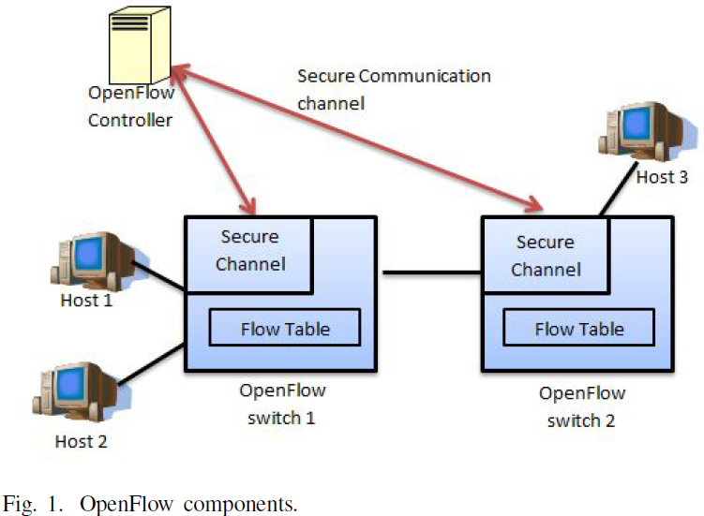
Openflow Specification

Slide 6
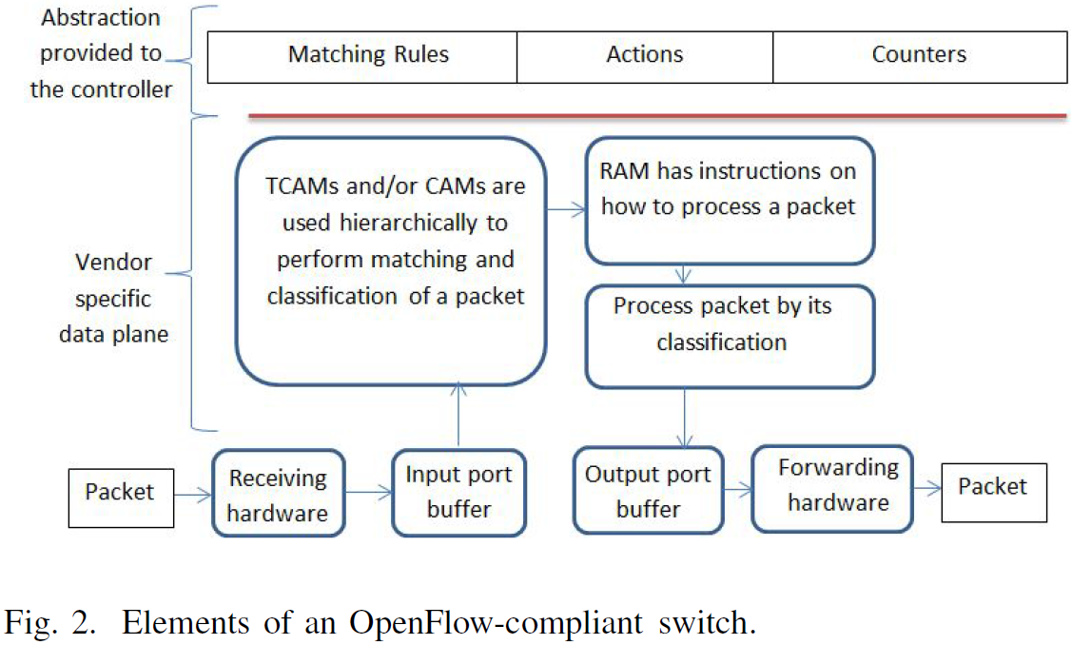
Openflow Specification (Cont.)

Slide 7
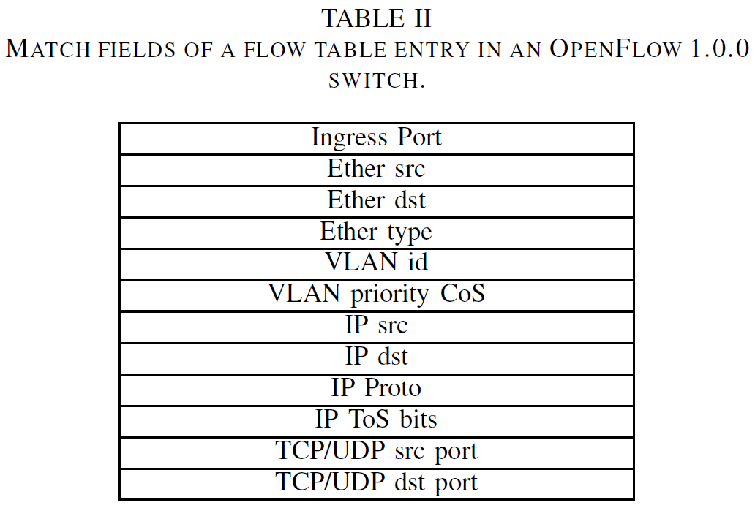
Openflow Specification (Cont.)
OpenFlow 1.0.0

Slide 8
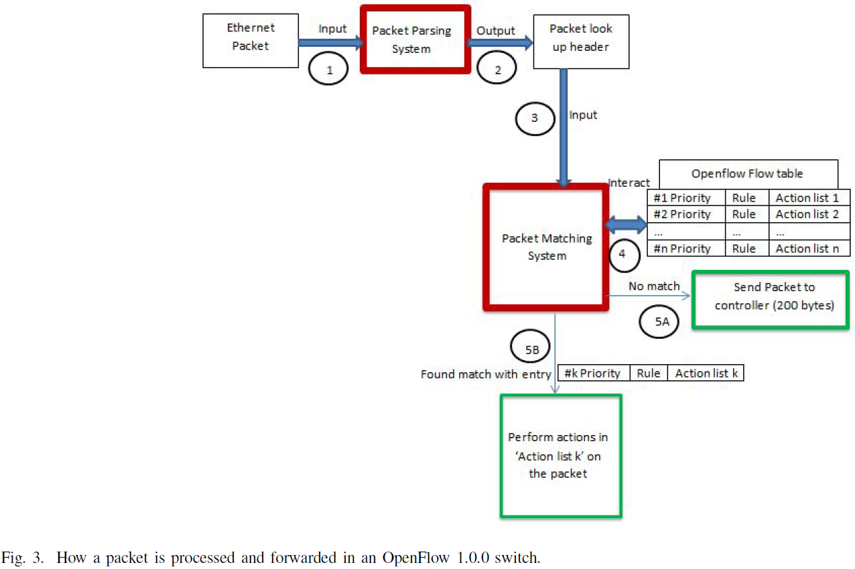
Openflow Specification (Cont.)
OpenFlow 1.0.0

Slide 9
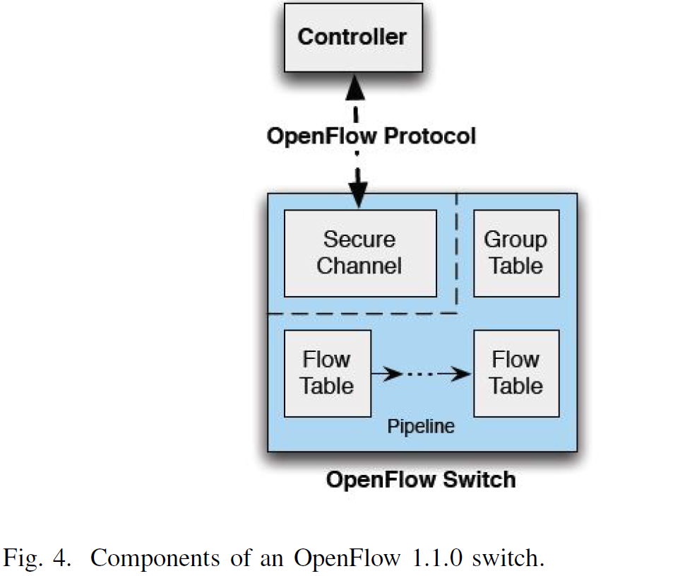
Openflow Specification (Cont.)
OpenFlow 1.1.0

Slide 10
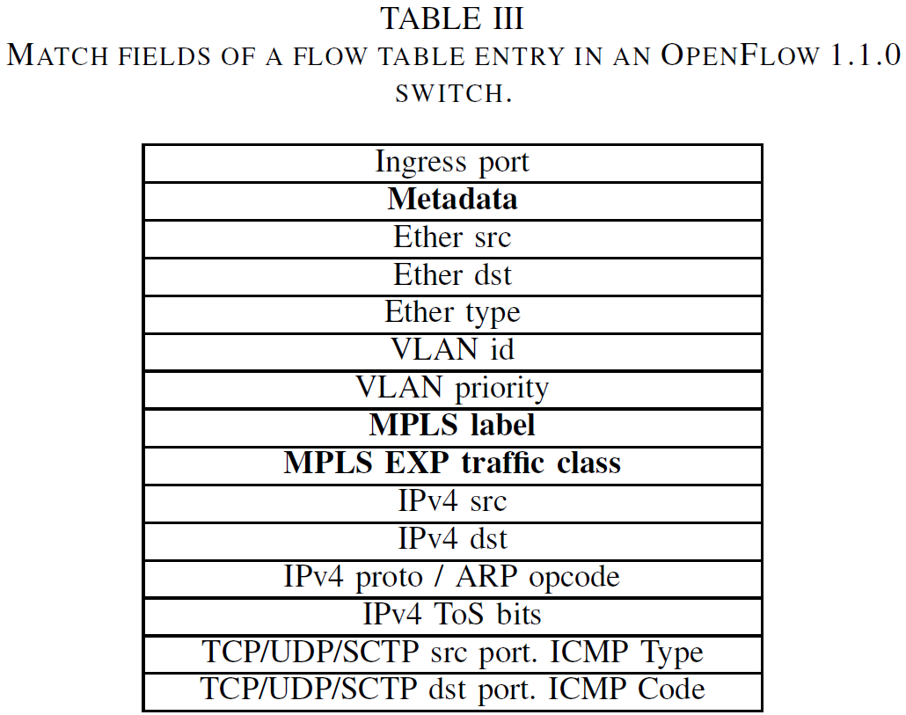
Openflow Specification (Cont.)
OpenFlow 1.1.0

Slide 11
Openflow Specification (Cont.)
OpenFlow 1.2
IPv6
Connect a switch to multiple controllers
OpenFlow 1.3.0
Control the rate of packets through per flow meters
Cookies can be added to the packets sent from the switch to the controller and specific durations field have been added to most statistics.

Slide 12
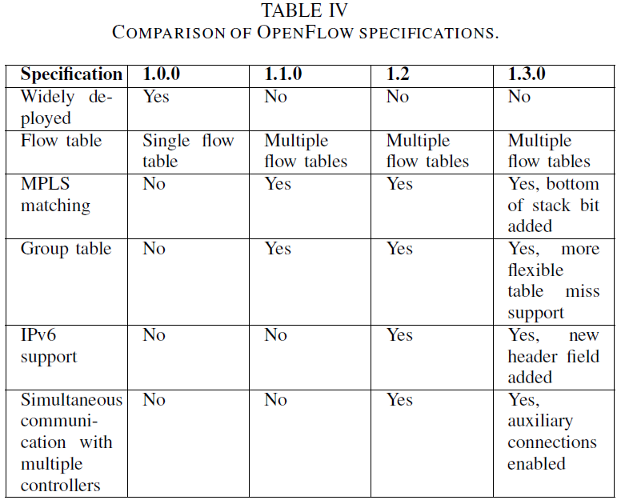
Openflow Specification (Cont.)

Slide 13
Openflow Specification (Cont.)
OpenFlow and SDN
SDN consists of decoupling the control plane from the data plane, whereas OpenFlow describes how a software controller and a switch should communicate in an SDN architecture.

Slide 14
Capabilities of Openflow
Centralized control of the network
Software-based traffic analysis
Dynamic updating of forwarding rules
Flow abstraction

Slide 15
Openflow-based Applications
Ease of configuration
Yamasaki et al. [52] proposed using OpenFlow to manage the VLANs of a campus network.
Reitblatt et al. [53] describe how to provide abstract operations that allow updating rules across the entire network in one fell swoop.

Slide 16
Openflow-based Applications (Cont.)
Network management
Mattos et al. [59] implemented a user friendly interface that allows the user to manage the network.
Voellmy et al. [61] propose Procera, a controller architecture and a high level network control language that can be used to reactively define network policies.

Slide 17
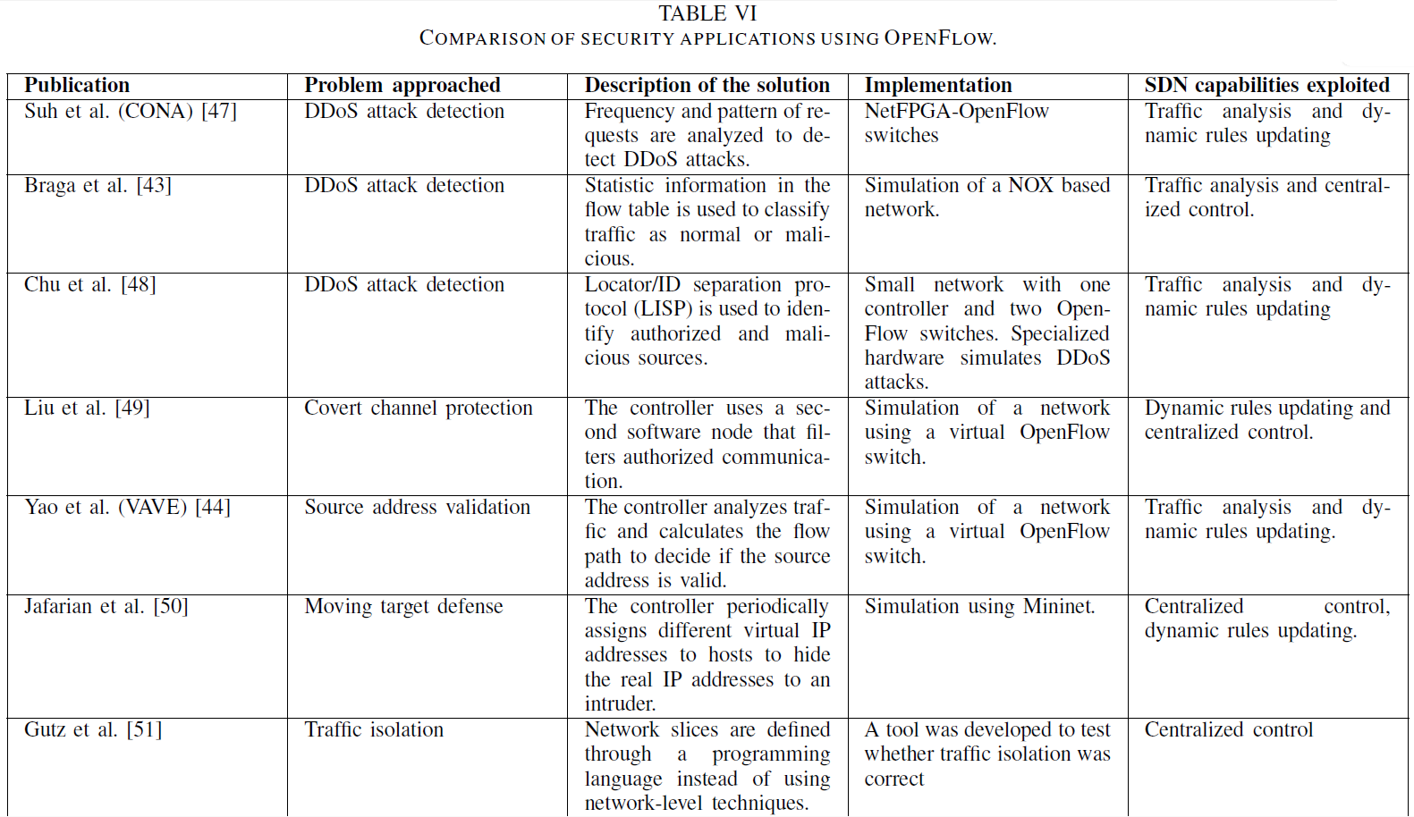
Openflow-based Applications (Cont.)
Security

Slide 18
Openflow-based Applications (Cont.)
Availability
Load balancing is a commonly used technique to distribute a working load between two or more nodes.
Fault tolerance refers to the property of a system to continue operating when a failure occurs.

Slide 19
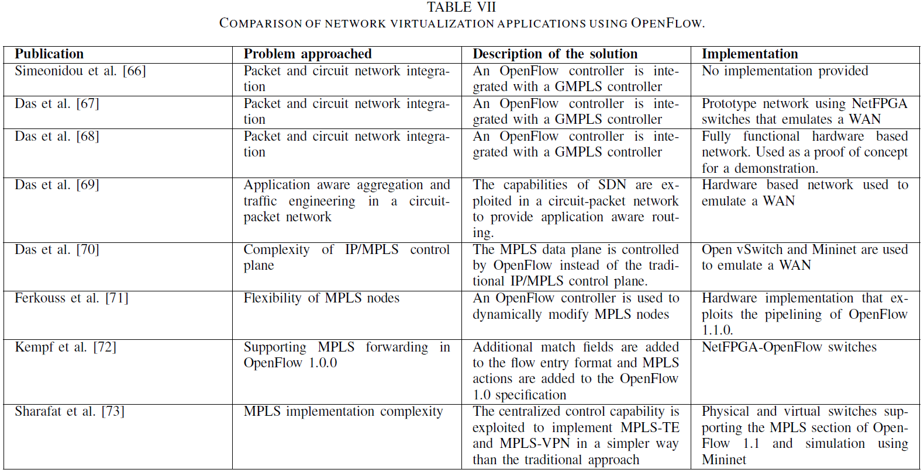
Openflow-based Applications (Cont.)
Network virtualization using MPLS and GMPLS

Slide 20
Openflow-based Applications (Cont.)
Data center virtualization
Wide area network applications
Wireless applications
Other applications

Slide 21
Performance of Openflow-based Networks
Measuring and modelling the performance of OpenFlow-based networks
Heller et al. [129] address two important questions regarding reliability, scalability and performance.
Improving the performance of OpenFlow-based networks
Yeganeh et al. [131] propose Kandoo, a framework that aims at reducing the number of events that are received at the control plane of the network.

Slide 22
Challenges of Openflow-based Networks
Security
Availability
Scalability
Survivability
CAPEX (capital expenses) and OPEX (operational expenses)
Compatibility

